Slide 1
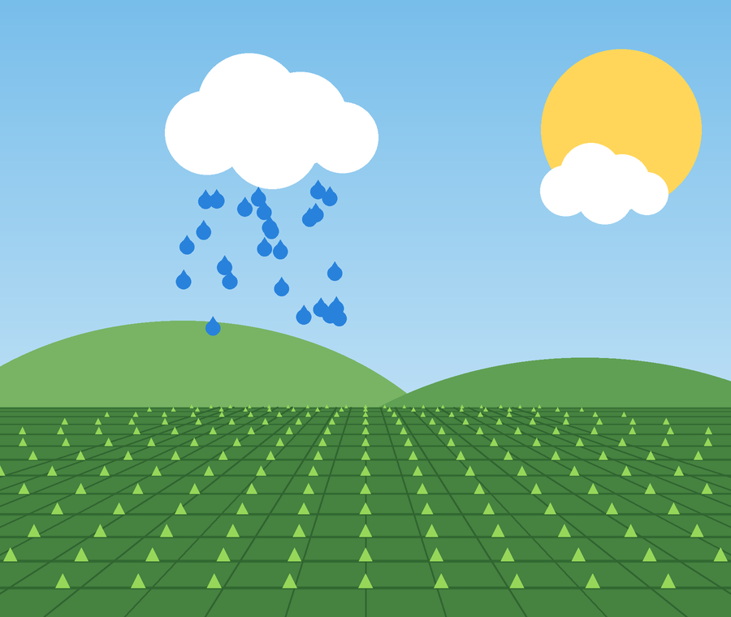
AGRICULTURE | AI + IoT
Jal rakshak
An AI-powered irrigation assistant that decides when to water, and explains why
Review 1 | Project Presentation
Notes:
Introduce AquaBot: tool-using AI agent for irrigation recommendations.

Slide 2
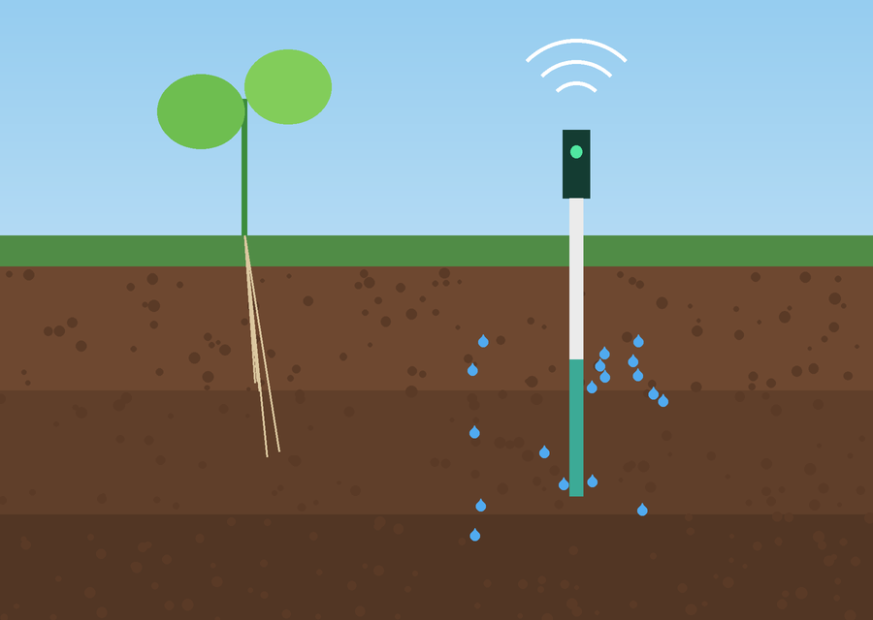
Problem Understanding & Relevance
The problem
Irrigation often runs on fixed schedules or manual observation, causing unnecessary water use, delayed watering and inefficient resource management.
Why it matters in agriculture
Reduces unnecessary watering
Supports more informed irrigation decisions
Checks the weather before recommending irrigation
Helps farmers monitor their fields
Illustration: soil sensor reading moisture
Combines soil moisture, weather and water availability to recommend appropriate irrigation actions.
Notes:
Many irrigation systems use fixed schedules without considering current soil conditions or upcoming rainfall. AquaBot combines soil moisture, weather information and water availability to recommend appropriate irrigation actions.

Slide 3
What Makes Jal Rakshak Different
More than a dashboard: a tool-using AI agent that gathers data, evaluates conditions and explains its recommendation.
22%
80%
Rain
Agent decision
Delay irrigation? Rain is expected
Soil moisture
Water availability
Forecast
simulated reading
simulated reading
from weather service
Important distinction
The LLM does not calculate the irrigation requirement. Reliable rule-based calculations and safety checks make the decision; the AI agent coordinates the analysis and explains the result in natural language. The modular design also lets us add real sensors and automated control.
Notes:
Unlike a threshold-based system, AquaBot is a tool-using AI agent. Moisture and water values shown are simulated.

Slide 4

System Architecture
Soil moisture sensor
ESP32 device
Backend server (FastAPI)
Irrigation engine
AI agent (Ollama)
React dashboard
Soil data
Weather service
Water level data
Data inputs feed the backend and engine
Output: recommendation and history on the dashboard
Rules decide; the AI agent explains. Readings and recommendations are stored in SQLite.
Notes:
Flow: sensor -> ESP32 -> backend -> data sources -> irrigation engine -> AI agent -> React dashboard.

Slide 5
Technology Stack
Component | Technology | Purpose
Frontend | React + Vite | Interactive dashboard
Backend | Python + FastAPI | API and application logic
AI model | Ollama + local LLM | Natural-language reasoning and explanations
Decision engine | Python | Irrigation rules and calculations
Weather | Open-Meteo | Weather forecast information
Database | SQLite | Store readings and recommendations
Hardware | ESP32 + soil moisture sensor | Real soil measurements when available
Notes:
Review 1: demo the React dashboard with simulated readings. Clearly label simulated data; separate planned hardware integration from completed functionality.

Slide 6
Execution Plan: Built in Stages
1
2
3
4
Build React dashboard
Develop backend API
Implement irrigation rules
Integrate Ollama
Show soil moisture and water availability
Move data between dashboard and server
Consistent recommendations
Agent explains recommendations
5
6
7
8
Integrate weather forecast
Add history storage
Integrate ESP32 and sensor
Test different conditions
Consider expected rainfall
Save readings and recommendations
If available: replace simulated readings
Dry soil, wet soil, low water
A working demo exists even if hardware is unavailable.
Notes:
Staged build so we always have a working demonstration. Stage 7 hardware is conditional.

Slide 7
Example Test Cases
Soil moisture | Water level | Weather | Expected behavior
Low | Sufficient | No rain expected | Consider recommending irrigation
Low | Sufficient | Heavy rain expected | Consider delaying irrigation
High | Sufficient | No rain expected | Avoid unnecessary irrigation
Low | Insufficient | No rain expected | Warn: water availability inadequate
These are initial scenarios. Final decisions will also consider crop requirements, soil type, field conditions and locally appropriate thresholds.
Notes:
Initial test scenarios only.

Slide 8
Demonstrating now
Planned, not yet complete
React dashboard with clearly labeled simulated readings
Backend, AI agent, weather integration and ESP32 hardware
Notes:
Be clear which items are simulated or planned versus completed.

